Slide 1
Object-Oriented Systems Development:
Using the Unified Modeling Language
Chapter 5:
Unified Modeling Language
Object-Oriented Systems Development Bahrami © Irwin/ McGraw-Hill

Slide 2

Goals
Modeling.
Unified modeling language.
  Class diagram.
  Use case diagram.
  Interaction diagrams.
    Sequence diagram.
    Collaboration diagram.
Object-Oriented Systems Development Bahrami © Irwin/ McGraw-Hill

Slide 3
Goals (Con’t)
  Statechart diagram.
  Activity diagram.
  Implementation diagrams.
    Component diagram.
    Deployment diagram.
Object-Oriented Systems Development Bahrami © Irwin/ McGraw-Hill

Slide 4

Introduction
A model is an abstract representation of a system, constructed to understand the system prior to building or modifying it.
Most of the modeling techniques involve graphical languages.
Object-Oriented Systems Development Bahrami © Irwin/ McGraw-Hill

Slide 5
Static or Dynamic Models
Models can represent
  static or
  dynamic situations.
Object-Oriented Systems Development Bahrami © Irwin/ McGraw-Hill

Slide 6
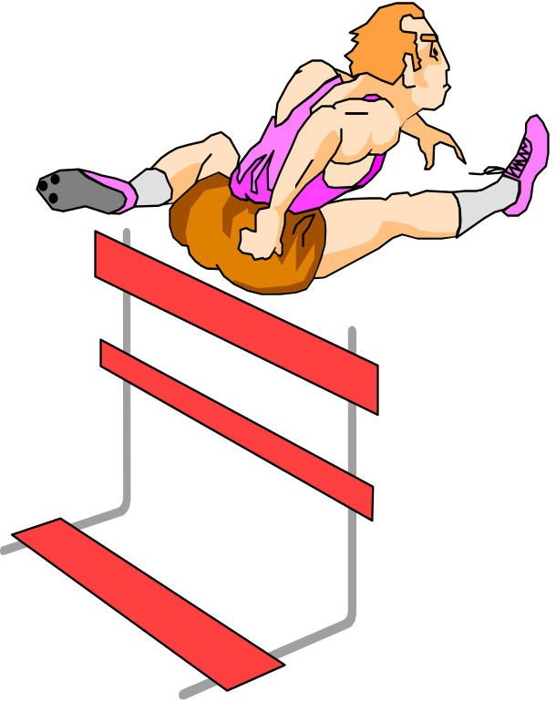
Static Model
A static model can be viewed as a "snapshot" of a system's parameters at rest or at a specific point in time.
The classes’ structure and their relationships to each other frozen in time are examples of static models.
Object-Oriented Systems Development Bahrami © Irwin/ McGraw-Hill

Slide 7
Dynamic Model
Is a collection of procedures or behaviors that, taken together, reflect the behavior of a system over time.
For example, an order interacts with inventory to determine product availability.
Object-Oriented Systems Development Bahrami © Irwin/ McGraw-Hill

Slide 8
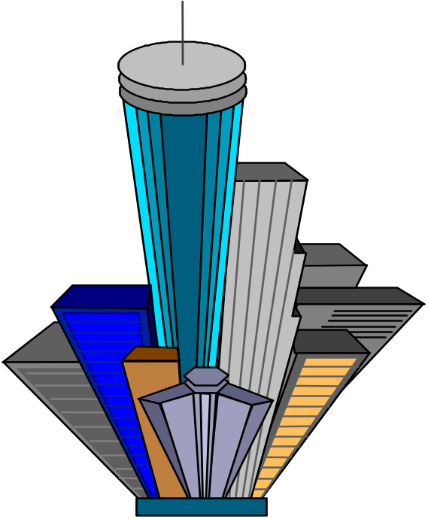
Why Modeling?
Turban cites the following advantages:
Models make it easier to express complex ideas.
For example, an architect builds a model to communicate ideas more easily to clients.
Object-Oriented Systems Development Bahrami © Irwin/ McGraw-Hill

Slide 9
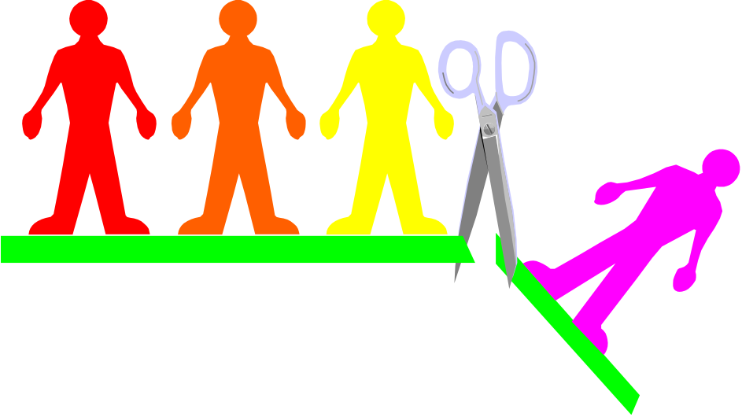
Advantages of Modeling (Con’t)
Models reduce complexity by separating those aspects that are unimportant from those that are important.
Object-Oriented Systems Development Bahrami © Irwin/ McGraw-Hill

Slide 10
Advantages of Modeling (Con’t)
Models enhance learning.
The cost of the modeling analysis is much lower than the cost of similar experimentation conducted with a real system.
Manipulation of the model (changing variables) is much easier than manipulating a real system.
Object-Oriented Systems Development Bahrami © Irwin/ McGraw-Hill

Slide 11

Modeling Key Ideas
A model is rarely correct on the first try.
Always seek the advice and criticism of others.
Avoid excess model revisions, as they can distort the essence of your model. Let simplicity and elegance guide you through the process.
Object-Oriented Systems Development Bahrami © Irwin/ McGraw-Hill

Slide 12
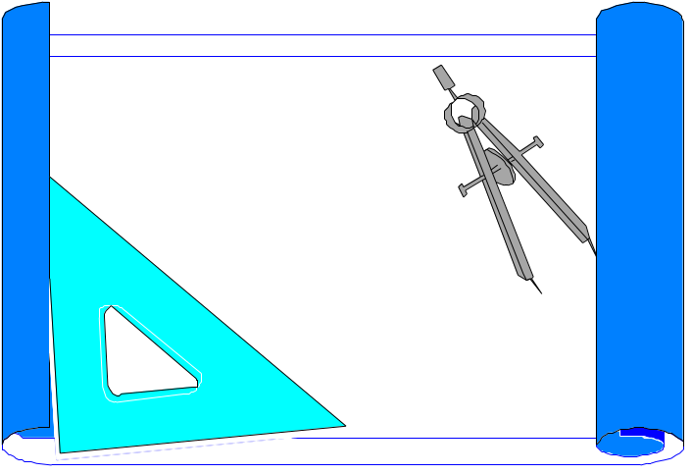
The Unified Modeling Language (UML)
The unified modeling language (UML) is a language for specifying, constructing, visualizing, and documenting the software system and its components.
Object-Oriented Systems Development Bahrami © Irwin/ McGraw-Hill
Notes:
The primary goals in the design of the UML were as follows :
Provide users a ready-to-use, expressive visual modeling language so they can develop and exchange meaningful models.
Provide extensibility and specialization mechanisms to extend the core concepts.
Be independent of particular programming languages and development processes.
Provide a formal basis for understanding the modeling language.
Encourage the growth of the OO tools market.
Support higher-level development concepts
Integrate best practices and methodologies.

Slide 13
UML Diagrams
The UML defines nine graphical diagrams:
1. Class diagram (static)
2. Use-case diagram
3. Behavior diagrams (dynamic):
  3.1. Interaction diagram:
    3.1.1. Sequence diagram
    3.1.2. Collaboration diagram
Object-Oriented Systems Development Bahrami © Irwin/ McGraw-Hill

Slide 14
UML Diagrams
  3.2. Statechart diagram
  3.3. Activity diagram
4. Implementation diagram:
  4.1. Component diagram
  4.2. Deployment diagram
Object-Oriented Systems Development Bahrami © Irwin/ McGraw-Hill

Slide 15
UML Class Diagram,
The UML class diagram is the main static analysis diagram.
Class diagrams show the static structure of the model.
Class diagram is collection of static modeling elements, such as classes and their relationships.
Object-Oriented Systems Development Bahrami © Irwin/ McGraw-Hill

Slide 16
Class Notation
In class notation, either or both the attributes and operation compartments may be suppressed.
Boeing 737
Boeing 737
length: meter
fuelCapacity: Gal
Boeing 737
doors: int
length: meter
fuelCapacity: Gal
lift ()
doors: int
break ()
Object-Oriented Systems Development Bahrami © Irwin/ McGraw-Hill

Slide 17
Class Interface Notation
Class interface notation is used to describe the externally visible behavior of a class.
For example, an operation with a public visibility.
Object-Oriented Systems Development Bahrami © Irwin/ McGraw-Hill
Notes:
Interface notation of a class.

Slide 18
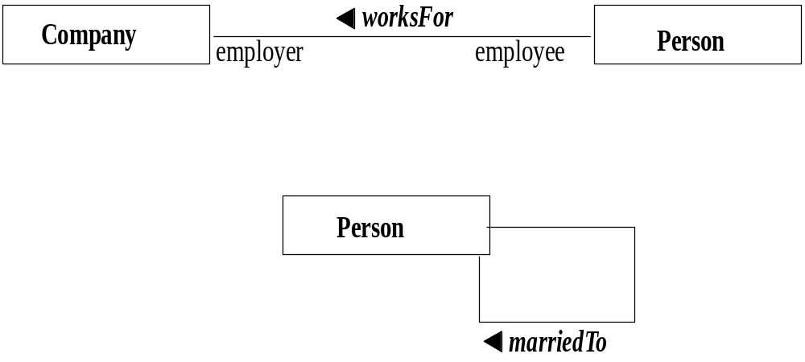
Binary Association Notation
A binary association is drawn as a solid path connecting two classes or both ends may be connected to the same class.
Object-Oriented Systems Development Bahrami © Irwin/ McGraw-Hill
Notes:
Association notation.

Slide 19
Association Role
A simple association—the technical term for it is binary association—is drawn as a solid line connecting two class symbols.
The end of an association, where it connects to a class, shows the association role.
Object-Oriented Systems Development Bahrami © Irwin/ McGraw-Hill

Slide 20
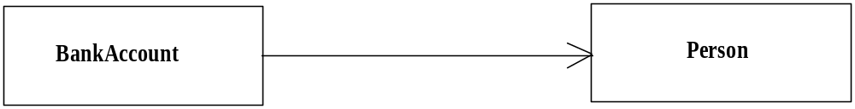
UML Association Notation
In the UML, association is represented by an open arrow.
Object-Oriented Systems Development Bahrami © Irwin/ McGraw-Hill

Slide 21
Qualifier
A qualifier is an association attribute. For example, a person object may be associated to a Bank object.
An attribute of this association is the account#.
The account# is the qualifier of this association.
Bank
account#
*
0..1
Person
.
Object-Oriented Systems Development Bahrami © Irwin/ McGraw-Hill

Slide 22
Multiplicity
Multiplicity specifies the range of allowable associated classes.
It is given for roles within associations, parts within compositions, repetitions, and other purposes.
lower bound .. upper bound.
Object-Oriented Systems Development Bahrami © Irwin/ McGraw-Hill

Slide 23
OR Association
An OR association indicates a situation in which only one of several potential associations may be substantiated at one time for any single object.
Person
Car
{or}
Company
Object-Oriented Systems Development Bahrami © Irwin/ McGraw-Hill

Slide 24
Association Class
An association class is an association that also has class properties.
An association class is shown as a class symbol attached by a dashed line to an association path.
Company
Person
employer
employee
WorksFor
salary
Object-Oriented Systems Development Bahrami © Irwin/ McGraw-Hill

Slide 25
N-Ary Association
An n-ary association is an association among more than two classes.
Since n-ary association is more difficult to understand, it is better to convert an n-ary association to binary association.
Year
semester
*
*
*
Class
Student
class
student
GradeBook
grade
exam
lab
Object-Oriented Systems Development Bahrami © Irwin/ McGraw-Hill

Slide 26
Aggregation
Aggregation is a form of association.
A hollow diamond is attached to the end of the path to indicate aggregation.
Object-Oriented Systems Development Bahrami © Irwin/ McGraw-Hill

Slide 27
Composition
Composition, also known as the a-part-of, is a form of aggregation with strong ownership to represent the component of a complex object.
The UML notation for composition is a solid diamond at the end of a path.
1
Car
1
1
1
4
4,10
2,5
1
graphical composition
Wheel
Light
Door
Engine
Car
4
Car
Wheel
4
4,10
Wheel
nested composition
Light
4,10
2,5
Light
Door
2,5
1
Door
Engine
1
Engine
Object-Oriented Systems Development Bahrami © Irwin/ McGraw-Hill

Slide 28
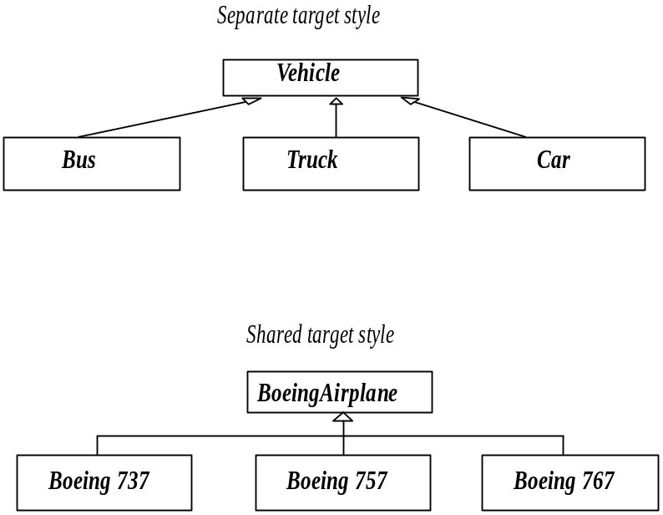
Generalization
Generalization is the relationship between a more general class and a more specific class.
Generalization is displayed as directed line with a closed, hollow arrowhead at the superclass end.
Object-Oriented Systems Development Bahrami © Irwin/ McGraw-Hill

Slide 29
Use-Case Diagram
The description of a use case defines what happens in the system when the use case is performed.
In essence, the use-case model defines the outside (actors) and inside (use case) of the system's behavior.
Object-Oriented Systems Development Bahrami © Irwin/ McGraw-Hill

Slide 30
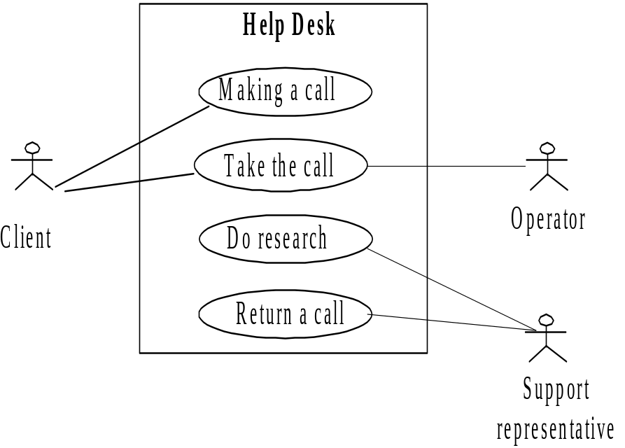
Use-Case Diagram (Con’t)
A use-case diagram is a graph of actors, a set of use cases enclosed by a system boundary, communication (participation) associations between the actors and the use cases, and generalization among the use cases.
Object-Oriented Systems Development Bahrami © Irwin/ McGraw-Hill
Notes:
A Use-case diagram shows the relationship among actors and use cases within a system.

Slide 31
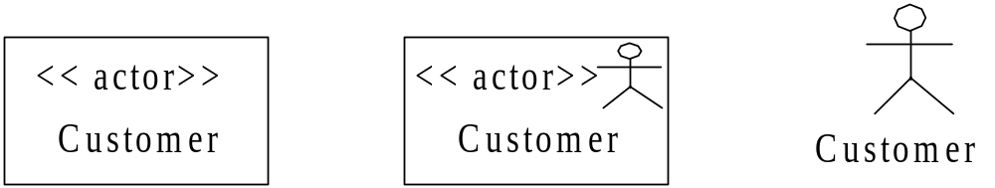
Actor Notations
The three representations of an actor are equivalent.
Object-Oriented Systems Development Bahrami © Irwin/ McGraw-Hill

Slide 32
Use-Case Diagram (Con’t)
These relationships are shown in a use-case diagram:
  Communication.
  Uses.
  Extends.
Object-Oriented Systems Development Bahrami © Irwin/ McGraw-Hill
Notes:
These relationships are shown in a use-case diagram:
Communication. The communication relationship of an actor in a use case is shown by connecting the actor symbol to the use-case symbol with a solid path. The actor is said to "communicate" with the use case.
Uses. A uses relationship between use cases is shown by a generalization arrow from the use case.
Extends. The extends relationship is used when you have one use case that is similar to another use case but does a bit more. In essence, it is like a subclass.

Slide 33

Behavior or Dynamic Diagrams
Interaction diagrams:
  Sequence diagrams
  Collaboration diagrams
Statechart diagrams
Activity diagrams
Object-Oriented Systems Development Bahrami © Irwin/ McGraw-Hill

Slide 34
UML Interaction Diagrams
Interaction diagrams describe how groups of objects collaborate to get the job done.
Interaction diagrams capture the behavior of a single use case, showing the pattern of interaction among objects.
Object-Oriented Systems Development Bahrami © Irwin/ McGraw-Hill

Slide 35
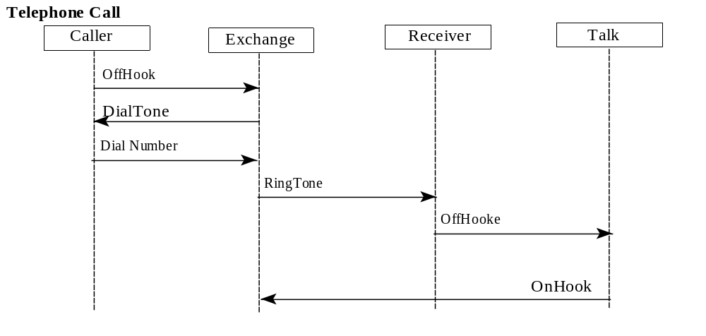
UML Sequence Diagram
Sequence diagrams are an easy and intuitive way of describing the behavior of a system.
A sequence diagram shows an interaction arranged in a time sequence.
Object-Oriented Systems Development Bahrami © Irwin/ McGraw-Hill

Slide 36
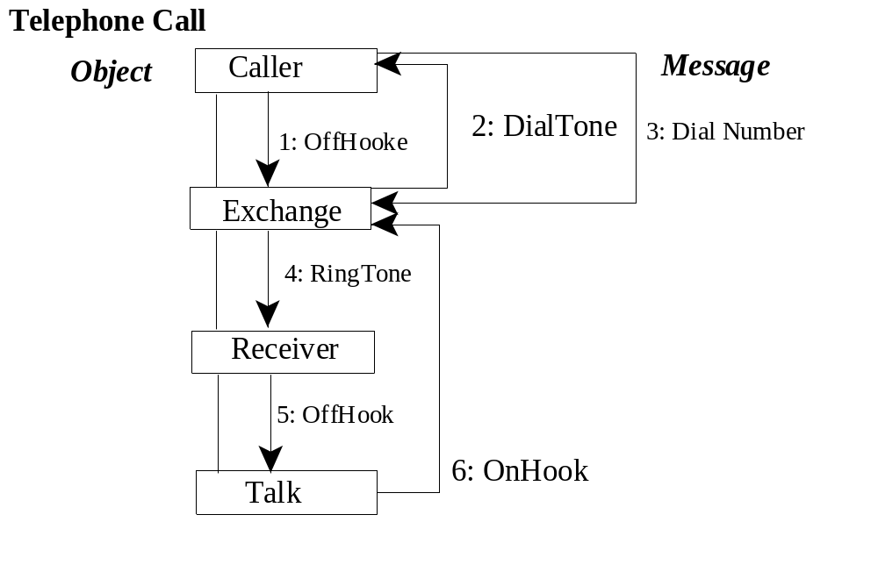
UML Collaboration Diagram
A collaboration diagram represents a set of objects related in a particular context, and the exchange of their messages to achieve a desired outcome.
Object-Oriented Systems Development Bahrami © Irwin/ McGraw-Hill

Slide 37
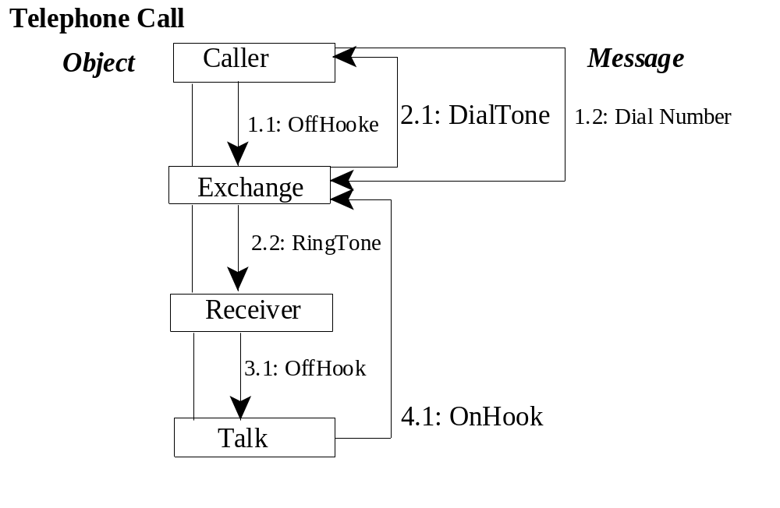
UML Collaboration Diagram (Con’t)
Object-Oriented Systems Development Bahrami © Irwin/ McGraw-Hill
Notes:
A collaboration diagram with decimal numbering.

Slide 38
UML Statechart Diagram
A statechart diagram (also called a state diagram) shows the sequence of states that an object goes through during its life in response to outside stimuli and messages.
Object-Oriented Systems Development Bahrami © Irwin/ McGraw-Hill

Slide 39
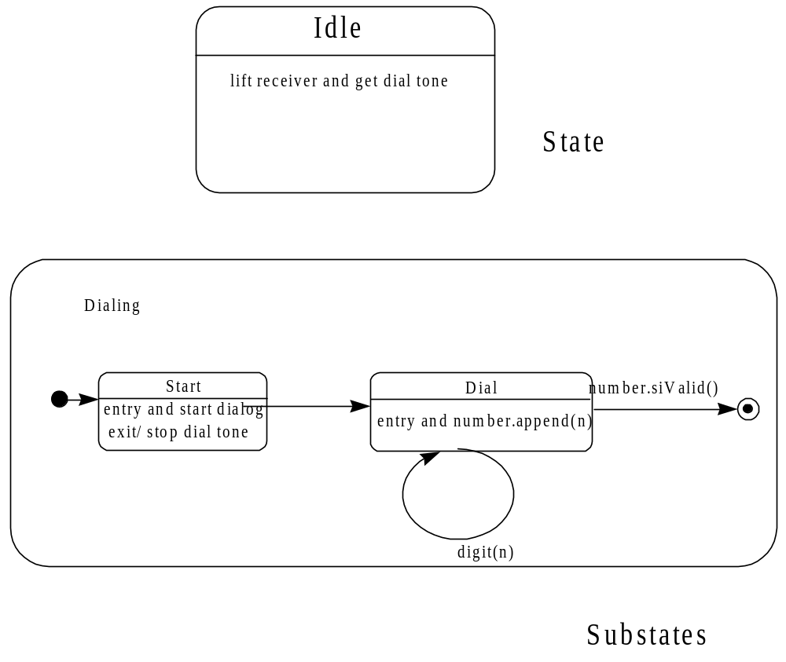
Object-Oriented Systems Development Bahrami © Irwin/ McGraw-Hill
Notes:
A simple state Idle and a nested state. The dialing state contains substates which consist of start and dial states.

Slide 40
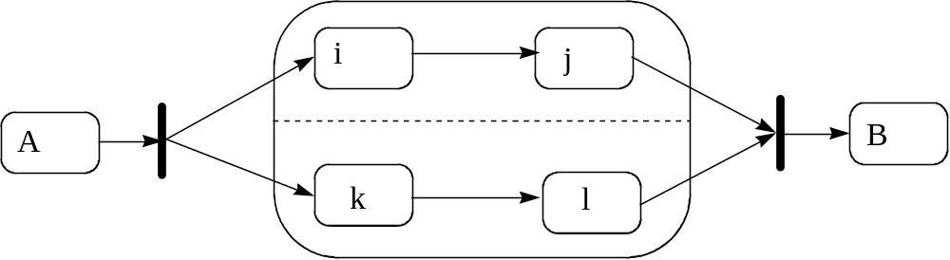
Complex Transition
Object-Oriented Systems Development Bahrami © Irwin/ McGraw-Hill

Slide 41
UML Activity Diagram
An activity diagram is a variation or special case of a state machine, in which the states are activities representing the performance of operations and the transitions are triggered by the completion of the operations.
Object-Oriented Systems Development Bahrami © Irwin/ McGraw-Hill

Slide 42
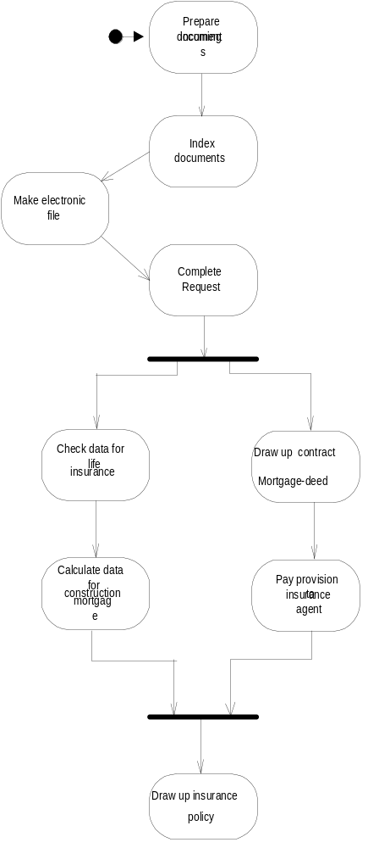
UML Activity Diagram (Con’t)
Object-Oriented Systems Development Bahrami © Irwin/ McGraw-Hill

Slide 43
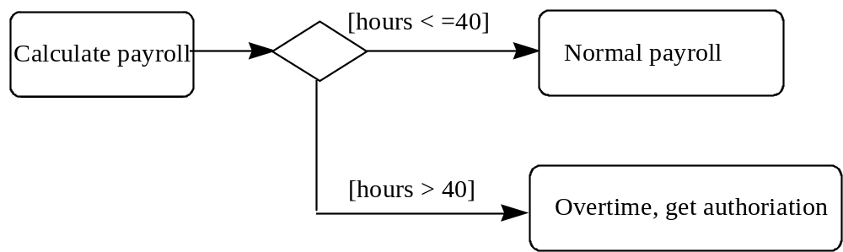
UML Activity Decision
Object-Oriented Systems Development Bahrami © Irwin/ McGraw-Hill

Slide 44
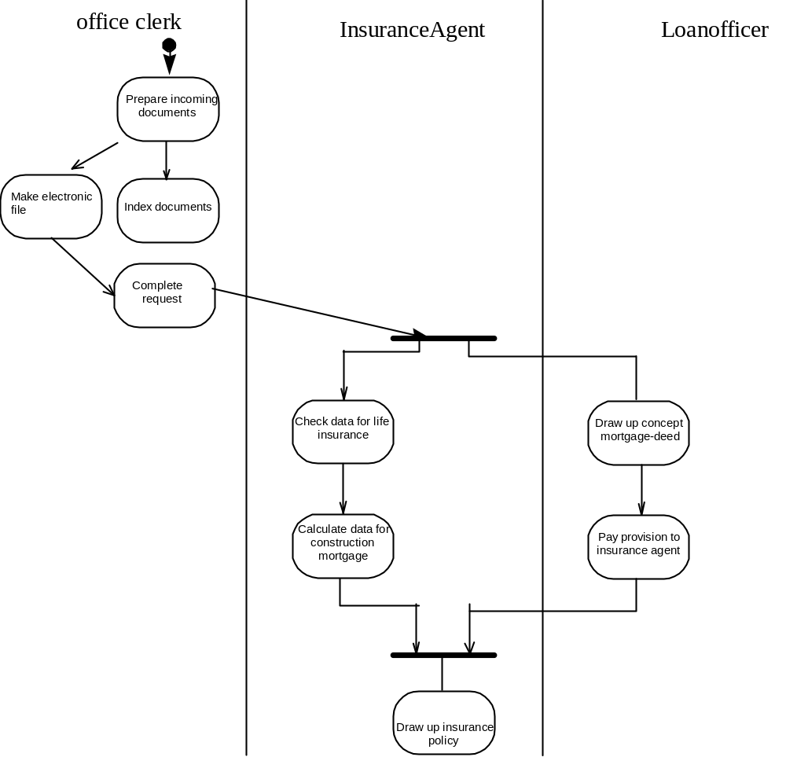
Swimlanes.
Object-Oriented Systems Development Bahrami © Irwin/ McGraw-Hill
Notes:
Actions maybe organized into swimlanes, each separated from neighboring swimlanes by vertical solid lines on both sides. Each swimlane represents responsibility for part of the overall activity and may be implemented by one or more objects. The relative ordering of the swimlanes has no semantic significance but might indicate some affinity.

Slide 45
Implementation diagrams
These diagrams show the implementation phase of systems development.
Such as the source code structure and the run-time implementation structure.
Object-Oriented Systems Development Bahrami © Irwin/ McGraw-Hill

Slide 46
Implementation diagrams (Con’t)
There are two types of implementation diagrams:
  Component diagrams show the structure of the code itself.
  Deployment diagrams show the structure of the run-time system.
Object-Oriented Systems Development Bahrami © Irwin/ McGraw-Hill

Slide 47
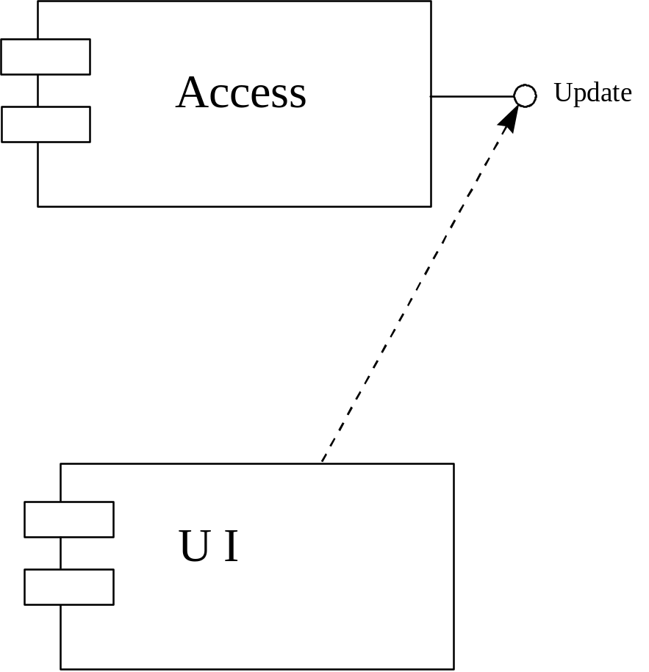
Component diagrams
Object-Oriented Systems Development Bahrami © Irwin/ McGraw-Hill

Slide 48
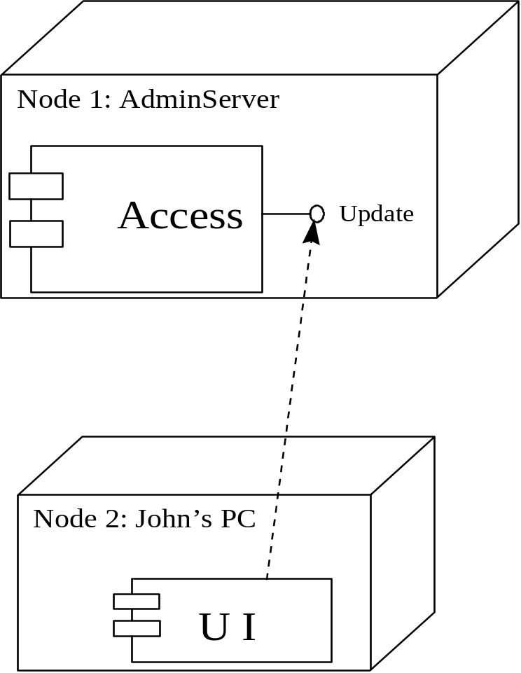
Deployment Diagram
Object-Oriented Systems Development Bahrami © Irwin/ McGraw-Hill

Slide 49
Model Management: Package
A package is a grouping of model elements.
Packages themselves may contain other packages.
A package may contain both subordinate packages and ordinary model elements.
Object-Oriented Systems Development Bahrami © Irwin/ McGraw-Hill

Slide 50
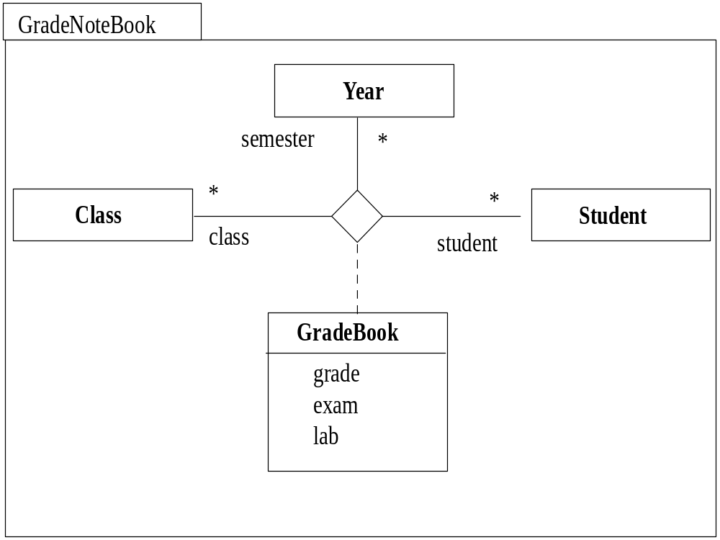
A Package and Its Contents
Object-Oriented Systems Development Bahrami © Irwin/ McGraw-Hill

Slide 51
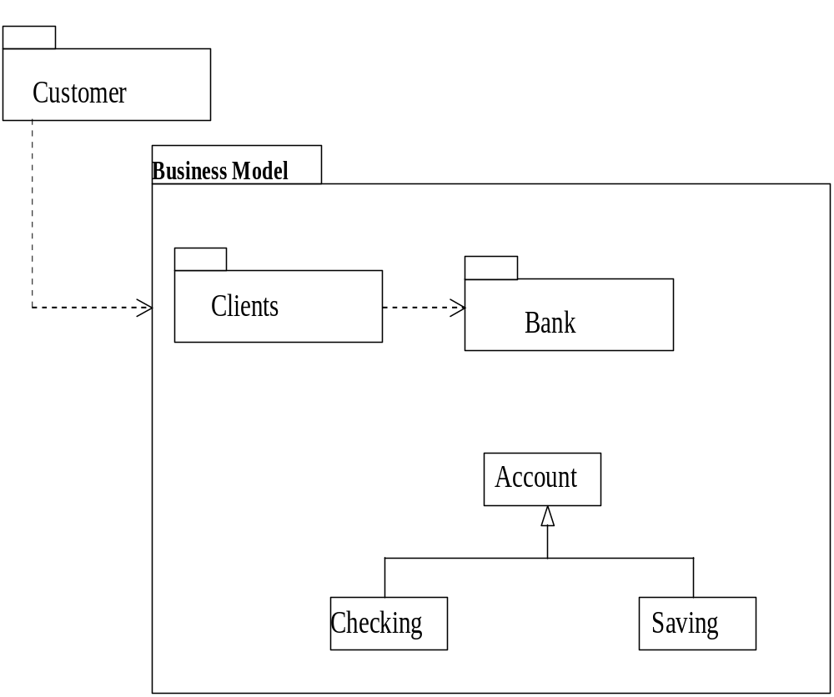
A Package and Its Dependencies
Object-Oriented Systems Development Bahrami © Irwin/ McGraw-Hill

Slide 52
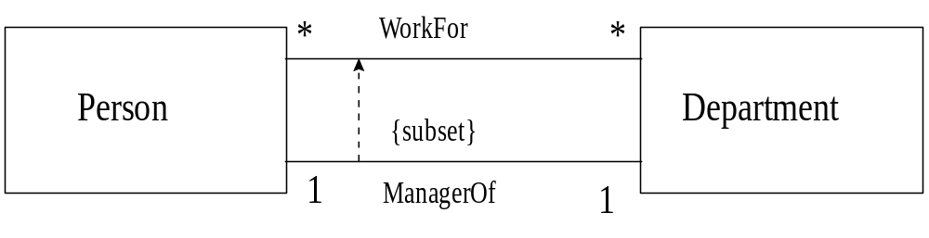
Model Constraints and Comments
Constraints are assumptions or relationships among model elements specifying conditions and propositions that must be maintained as true otherwise the system described by the model would be invalid.
Object-Oriented Systems Development Bahrami © Irwin/ McGraw-Hill
Notes:
An example of constraints. A person is a manager of people who works for the accounting department.

Slide 53
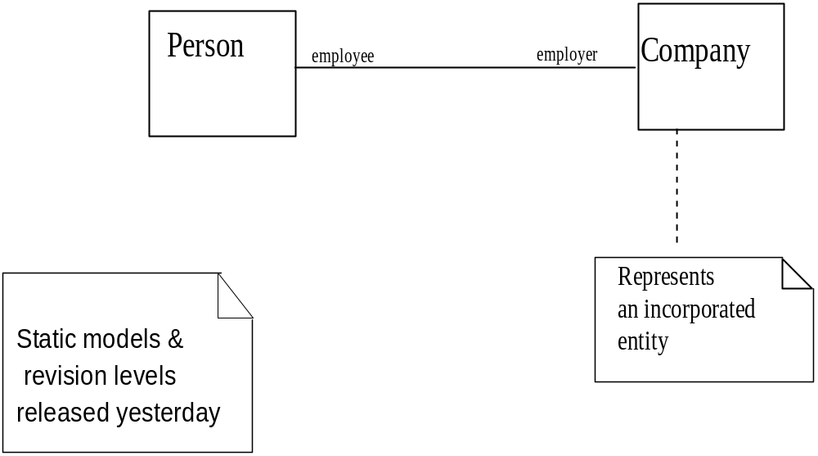
Note
A note is a graphic symbol containing textual information; it also could contain embedded images.
Object-Oriented Systems Development Bahrami © Irwin/ McGraw-Hill

Slide 54
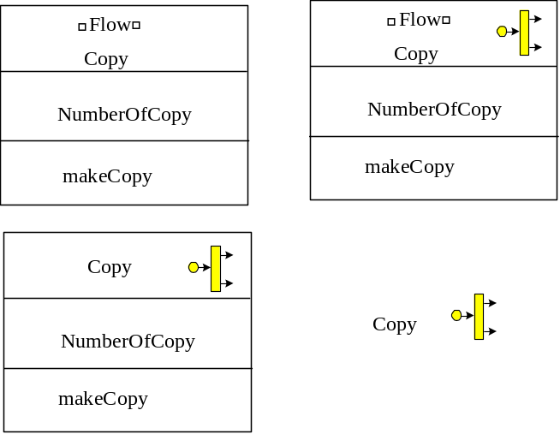
Stereotype
Stereotypes represent a built-in extendibility mechanism of the UML.
User-defined extensions of the UML are enabled through the use of stereotypes and constraints.
Object-Oriented Systems Development Bahrami © Irwin/ McGraw-Hill

Slide 55
UML Meta-Model
A meta-model is a model of modeling elements.
The purpose of the UML meta-model is to provide a single, common, and definitive statement of the syntax and semantics of the elements of the UML.
Object-Oriented Systems Development Bahrami © Irwin/ McGraw-Hill

Slide 56
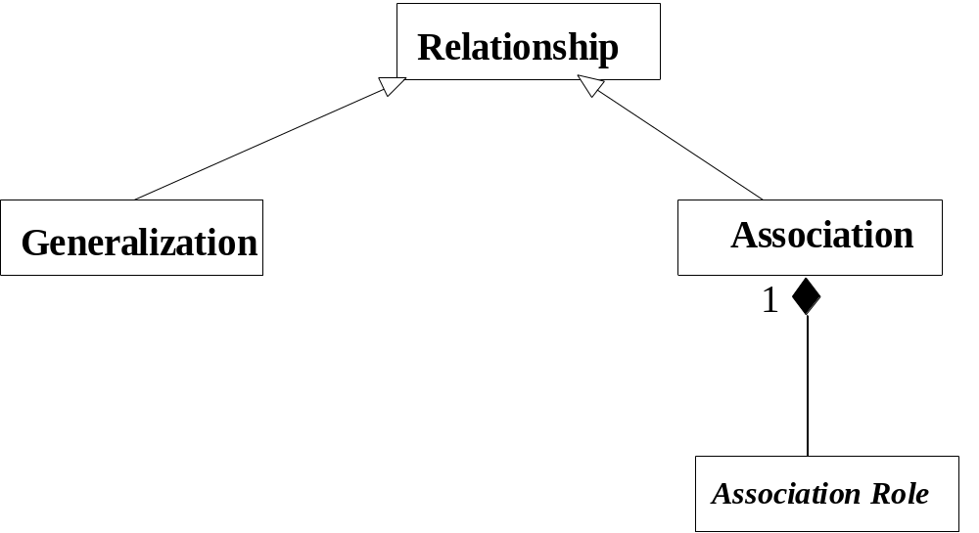
UML Meta-Model (Con’t)
Object-Oriented Systems Development Bahrami © Irwin/ McGraw-Hill
Notes:
The UML meta-model describing the relationship between association and generalization. Association is depicted as composition of association roles. Here, we use UML modeling elements (such as generalization and composition) to describe the model itself, hence, the term metamodel.

Slide 57

Summary
A model is a simplified representation of reality.
The unified modeling language (UML) was developed by Booch, Jacobson, and Rumbaugh and encompasses the unification of their modeling notations.
Object-Oriented Systems Development Bahrami © Irwin/ McGraw-Hill

Slide 58
Summary (Con’t)
UML consists of the following diagrams:
  Class diagram.
  Use case diagram.
  Sequence diagram.
  Collaboration diagram.
Object-Oriented Systems Development Bahrami © Irwin/ McGraw-Hill

Slide 59
Summary (Con’t)
  Statechart diagram.
  Activity diagram.
  Component diagram.
  Deployment diagram.
Object-Oriented Systems Development Bahrami © Irwin/ McGraw-Hill

